Slide 1
Thrombin Assay

Slide 2
Thrombin Substrate
PEPTIDE | SEQUENCE | CHARGE
Substrate | Acetyl-N-D⁻D⁻-{Nle}-TPR⁺/GSAGAGAG- diamino-ethyl-BFL | -1
Cleaved Fragments
N-terminal | Acetyl-N-D⁻D⁻-{Nle}-TPR⁺-O⁻ | -1
C-terminal | H₃N⁺-GSAGAGAG- diamino-ethyl-BFL- | +1

Slide 3
Thrombin Assay
Collect blood in untreated blood collection tube- Serum Tube
Combine the blood and the thrombin specific substrate
The net charge of the thrombin substrate is -1; when thrombin cleaves produces a -2 charged fragment and a +1 fluorescently labeled fragment
Add EDTA to Stop the reaction
EDTA chelates the Calcium in the blood, and thus Thrombin is inhibited
Separate the cleaved-labeled product from the un-cleaved substrate
An electric field is applied to achieve this

Slide 4
BLOOD SAMPLE
SUBSTRATE
BFL
Ac-NDDNleTPRGSAGAGAG-NH₂
BFL
Thrombin
Ac-NDDNleTPR-O
H₃N-GSAGAGAG-NH₂

Slide 5
BLOOD SAMPLE
SUBSTRATE
EDTA
SUBSTRATE
BFL
Ac-NDDNleTPRGSAGAGAG-NH₂
EDTA
BFL
Ac-NDDNleTPRGSAGAGAG-NH₂
Thrombin

Slide 6
Thrombin Assay Diagram
Reaction Tube
Substrate+ Blood
+ EDTA
RBC
Un-cleaved Substrate
Product
Sample Well
Thrombin
Extraction Gel
EDTA
} Focusing Gel
Charge changing Substrate is added to a reaction tube
Fresh untreated blood is added to the tube
EDTA is added after some time desired
A polyacrylamide gel is loaded with the tube contents

Slide 7
Thrombin Assay Diagram
ANODE
CATHODE
5) Electric field is applied to the gel
6) Positive charged labeled substrate products travel to the cathode, everything else is negatively charged and travel to the anode
Increase Activity
Increase Reaction Time

Slide 8
Thrombin Assay Diagram
Focused Product
} Focusing Gel
8) After some time the labeled positively charged products get focused in the focusing gel
9) The gel is scanned in a STORM scanner, and the image is then analyzed
Increase Activity
Increase Reaction Time

Slide 9
Sample Results

Slide 10
Fresh Whole Blood - Thrombin Assay- EDTA
Time | Sample Vol (μL) | Subst Vol (μL) | EDTA (μL)
0 | 5.8 | 0.9 | 0.9
3 | 5.8 | 0.9 | 0.9
6 | 5.8 | 0.9 | 0.9
9 | 5.8 | 0.9 | 0.9
12 | 5.8 | 0.9 | 0.9
15 | 5.8 | 0.9 | 0.9
18 | 5.8 | 0.9 | 0.9
21 | 5.8 | 0.9 | 0.9
24 | 5.8 | 0.9 | 0.9
27 | 5.8 | 0.9 | 0.9
30 | 5.8 | 0.9 | 0.9
Calibration
Blood + T2 Substrate + EDTA
EDTA inhibits Thrombin action, and thus the reaction stops when it is added. As the reaction time increased, so did the thrombin activity
Reaction: Blood Samples with Substrate T2 (Thrombin); the reaction was stopped with EDTA at 3mins time intervals. Two different gels were ran in this experiment, and are represented in the graph. The total volume in the reaction was of 10 uL
Electrophoresis: 6 μL Loading in 20% Polyacrylamide, 10 min.@500V

Slide 11
HEP Blood - Thrombin Assay- EDTA
Time | Sample Vol (μL) | Subst Vol (μL) | EDTA (μL)
0 | 5.8 | 0.9 | 0.9
3 | 5.8 | 0.9 | 0.9
6 | 5.8 | 0.9 | 0.9
9 | 5.8 | 0.9 | 0.9
12 | 5.8 | 0.9 | 0.9
15 | 5.8 | 0.9 | 0.9
18 | 5.8 | 0.9 | 0.9
21 | 5.8 | 0.9 | 0.9
24 | 5.8 | 0.9 | 0.9
27 | 5.8 | 0.9 | 0.9
30 | 5.8 | 0.9 | 0.9
Calibration
No signal was detected when using HEP blood, this is as expected, since HEP inhibits thrombin activity
This can be used as a negative control, since HEP only inhibits thrombin activity, and thus since no signal is detected, then other proteases are not reacting with our thrombin substrate (T2).
Reaction: Blood Samples collected in HEP tubes reacted with Substrate T2 (Thrombin); the reaction was stopped with EDTA at 3mins time intervals. Two different gels were ran in this experiment, and are represented in the graph. The total volume in the reaction was of 10 uL
Electrophoresis: 6 μL Loading in 20% Polyacrylamide, 10 min.@500V

Slide 12
Aspirin Fresh Whole Blood- Thrombin Assay- EDTA
Time | Sample Vol (μL) | Subst Vol (μL) | EDTA (μL)
0 | 5.8 | 0.9 | 0.9
3 | 5.8 | 0.9 | 0.9
6 | 5.8 | 0.9 | 0.9
9 | 5.8 | 0.9 | 0.9
12 | 5.8 | 0.9 | 0.9
15 | 5.8 | 0.9 | 0.9
18 | 5.8 | 0.9 | 0.9
21 | 5.8 | 0.9 | 0.9
24 | 5.8 | 0.9 | 0.9
27 | 5.8 | 0.9 | 0.9
30 | 5.8 | 0.9 | 0.9
NA | Negative Control | Negative Control | Negative Control
NA | Control | Control | Control
Fresh blood was collected from subject, who took 2 aspirin pills before the blood draw (one at night, and one in the morning). The detection of signal of thrombin activity was delayed by approx. 5 min.
Reaction: Blood Samples ( containing traces of Aspirin) reacted with Substrate T2 (Thrombin); the reaction was stopped with EDTA at 3mins time intervals. Two different gels were ran in this experiment, and are represented in the graph. The total volume in the reaction was of 10 uL
Electrophoresis: 6 μL Loading in 20% Polyacrylamide, 10 min.@500V

Slide 13
Fresh Whole Blood- Thrombin Assay- EDTA (Aspirin and normal samples)
Normal Blood Sample:
Buffer
0 Reaction Time (min) 35
Aspirin Blood Sample:
Buffer
0 Reaction Time (min) 37

Slide 14
Calibration Curves: Citrate Blood +Thrombin
Lane | [Thrombin] nM
1 | 600
3 | 500
5 | 400
7 | 300
9 | 200
11 | 100
13 | 30
14 | Neg Control
15 | Neg Control
Citrated blood was added with Thrombin substrate (T2), and thrombin enzyme
As the thrombin enzyme increased so did the fluorescent signal
Reaction: Blood Samples with Substrate T2 (Thrombin) and thrombin enzyme ; the reactants were added into a reaction tube, and the reaction was allowed for 30 mins. The total volume in the reaction was 15uL.
Electrophoresis: 6 μL Loading in 20% Polyacrylamide, 10 min.@500V

Slide 15
Bacterial Proteases

Slide 16
OmpT
Outer membrane Bacterial Protease expressed by Escherichia coli
Structure:
10 stranded antiparallel β- Barrels , which protrudes out of the lipid bilayer
Active Site:
Proteolytic activity in the extracellular part of the membrane
This extracellular part of OMPT contains a large negatively charge groove: thus it has preference for Positively charged Residues

Slide 17
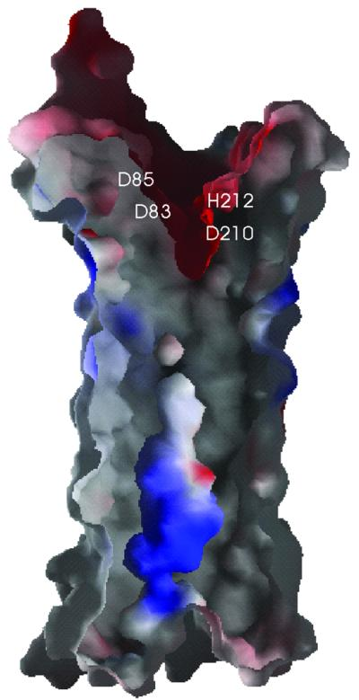
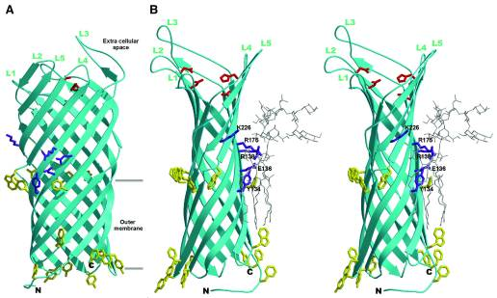
OmpT Structure
Electrostatic Surface Potential
Overall Structure of OmpT
Negative Charged Residues
Catalytic Residues
EMBO J. 2001 September 17; 20(18): 5033–5039.

Slide 18
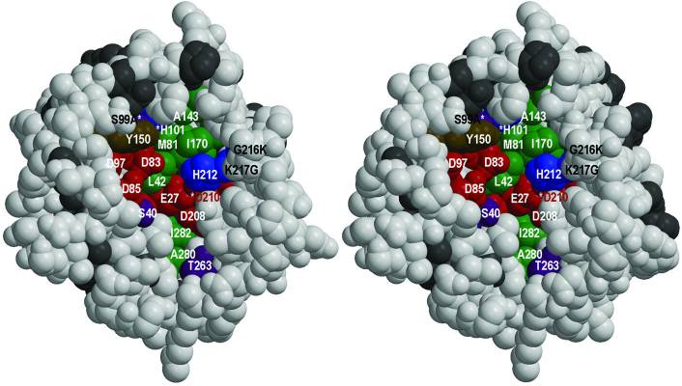
OmpT Structure
EMBO J. 2001 September 17; 20(18): 5033–5039.

Slide 19
OmpT Substrate Design
The substrate needs to meet the following requirements:
Specificity
Sensitivity
The whole substrate needs to have a net NEGATIVE CHARGE, the labeled fragment caused by the enzymatic cleavage of the substrate needs to have POSITIVE CHARGE
OmpT-Substrate Binding:
Amino acids in the substrate within six residue window contribute to the binding of it to OmpT:
P1: Arg requirement
P1’: Lys, Gly, Val , Arg
P2: Val or Al
P3 and P4: Trp or Arg

Slide 20
OmpT Substrate Design
Strategy
Identify OmpT specific peptide that is most negatively charged or close to neutral
Modify the ends of the peptide with charged amino acid residues
Determine the net charge of the entire substrate: must be negative. And also determine charge of the cleaved fractions: one of them must be positive (c-end)
Bind fluorophore to the positively charged fraction terminal

Slide 21
OmpT Substrate Design
Substrate Sequence of Interest
Determined by the following techniques
In situ cleavage of phage that display protease-susceptible peptides by E coli expressing OmpT
In vitro cleavage of phage-displayed peptides using purified enzyme
McCarter’s group narrowed it down to the following after testing all combinations in their library:

Slide 22
OmpT Substrate Design
Best sequence for charge changing substrate:
Ac-WGGK(+)YR(+) / R(+)AWGTI-NH₂
The peptide shown above has a net charge of +3. At least 4 negatively charged residues need to be added to the sequence, making the net charge of the substrate -1
- Must keep the peptide as short as possible to avoid complications in structure
Notice the synthetic substrate sequence is 10⁶ fold higher than peptide that corresponds to cleavage site of human plasminogen
Suggested Sequence:
Use Asp(D) as the negatively charged residue: less bulky than Glu(E)
Add most of the negative residues to the N-terminus, since this will be the unlabeled end.
This will make the label end of the substrate more positive, and the un-label more negative → Better separation

Slide 23
OmpT Substrate Design
Suggested Sequence:
Acetyl-W-GD(-)D(-)GD(-) K(+) YR(+) / R(+)AWGD(-)TI(diamino-ethyl BFL)-Ac
PEPTIDE | SEQUENCE | CHARGE
Substrate | Acetyl-W-GD(-)D(-)GD(-) K(+) YR(+) / R(+)AWGD(-)TI(diamino-ethyl BFL)-Ac | -1
Cleaved Fragments
N-terminal | Acetyl-W-GD(-)D(-)GD(-) K(+) YR(+) -O⁻ | -2
C-terminal | H₃N⁺-R(+)AWGD(-)TI(diamino-ethyl BFL)-Ac | +1

Slide 24
OmpT Assay
Similar to the thrombin assay, with the exception of a different substrate that targets OmpT.
Sample with OmpT enzyme
OmpT Specific substrate
Cleaved substrate

Slide 25
Pla
Yersinia pestis surface protease
An agent of plague and has been recognized as one of the most devastating, epidemic-causing bacteria experienced by mankind
9.5-kb plasmid pPCP expresses plague plasminogen activator (Pla)
Responsible for fibrinolytic and coagulase activities

Slide 26
Pla Substrate Design
Design strategy is very similar to the OmpT substrate
DABCYL-Arg(+) / Arg(+)-Ile-Asn-Arg(+)-Glu(-)(EDANS)-NH₂
DABCYL is quencher molecule, EDANS is fluorophore
+2 charge peptide sequence. Thus, we have to add -3 charge

Slide 27
Point of Care (POC) Device Hand Held Device

Slide 28
POC Device Sketch
Top View:
Negatively Charged Beads
Buffer Well: 1) 10- 20 μL
Electrode
Sample Well: 2) 5- 10 μL
and Lyophilized Substrate
Electrode
Channel with Filter Paper
Support:
Glass or Plastic

Slide 29
POC Device Sketch
Side View:
Sample Well
Buffer Well
Cover: glass or plastic: transparent
Wire Connection
Wire Connection
Electrode
Lyophilized Reagents:
-Charge Changing Substrate, Cofactors…
Electrode

Slide 30
POC Device Sketch
`
`
Buffer is added to the buffer gel:
Wetting the filter paper → electrolyte connection between buffer and the sample wells
2) Sample is added in the sample well:
Solubilizing the lyophilized reagents, and providing a connection between the sample, and buffer wells
3) The reagents, and the sample are allowed to react for 10-15 min
4) A DC electric field is applied
Sample chamber (+) charge; Buffer chamber (-) charge
5) The positive charge fluorescently labeled product is collected in the beads

Slide 31
POC Device Sketch
`
`
Batteries
6) After the product is collected in the beads, imaging can be done by adding an excitation source (laser) under the device, then a filter on top, and the image is detected by a CCD camera on top.
Detector: CCD Camera
Filter
`
Excitation Source: Laser

Slide 32
CATHEPSIN-S

Slide 33
CATHEPSIN-S
Lysosomal cysteine protease
Involve in multiple diseases: cancer, diabetes, cardiovascular diseases…
and…

Slide 34
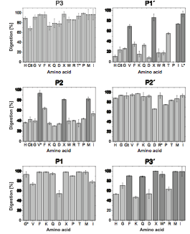
CATHEPSIN-S
GRWHTVG//LRWE-Lys(Dnp)-DArg- NH2
From the sequence above, single amino-acid were replaced, the result is shown:
The polypeptide seemed to be more sensitive to changes in P1’, P2,P1, and P3

Slide 35
CATHEPSIN-S
Broad substrate specificity → Specific substrate is not known, but from the sequence shown before, the substrate seems to prefer the followings:
Side Chain |  | P-2 | P-1 | P-1’ | P-3’
Hydrophobic | Aromatic Aliphatic Methionine Proline | +(only Phe) +(not Ile) + - | - + - - | - + - - | + + + Not tested
Neutral | Amide Small | - - | + + | - - | 0 -
Basic |  | - - | + + | 0 - | - -
Acidic |  | - | - | - | -

Slide 36
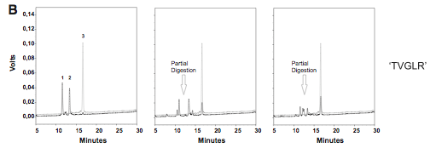
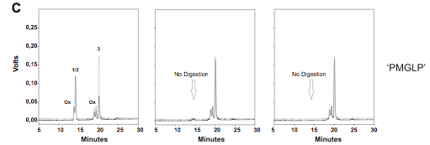
CATHEPSIN-S

Slide 37
CATHEPSIN-S
Comparing Substrates
Ac-N-GD- PVG // LTA GAGK(BFL)-NH₂ : Substrate for MMP2-9
Ac-GRWH-PMG // LPW ELys(Dnp)-DArg- NH2 : Substrate with higher specificity for CatS when compared to CatL, and CatB
The substrates are similar in the recognition sequence, so there might be non-specific cleavage of the substrate by MMP2/9 instead of Cathepsin S → might be better to sacrify the specificity in comparison to CatB and CatL than that due to MMP2/9 (elevated in the blood-from the diabetes studies)
Might be better to go with: Ac-GRWH-TVG // LR WE-Lys(Dnp)-DArg- NH2

Slide 38
CATHEPSIN-S
Substrate 1:
Ac-GR(+)WH-TV G // L R(+) WE-dR(+)-K(+)(BFL) NH2

